Slide 1
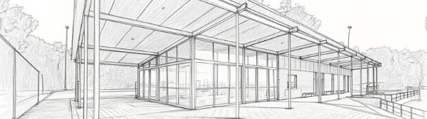
Glen Forrest Changerooms Upgrade
Design Workshop with Maarch Architects

Slide 2
Acknowledgement of Country
We wish to respectfully acknowledge the Whadjuk people of the Noongar Nation, who are the traditional custodians of this land.
We acknowledge Elders past, present and emerging and respect their continuing culture and the contribution they make to the region.
Notes:
SC: Welcome/ Acknowledgement of Country/House Keeping/Overview

Slide 3
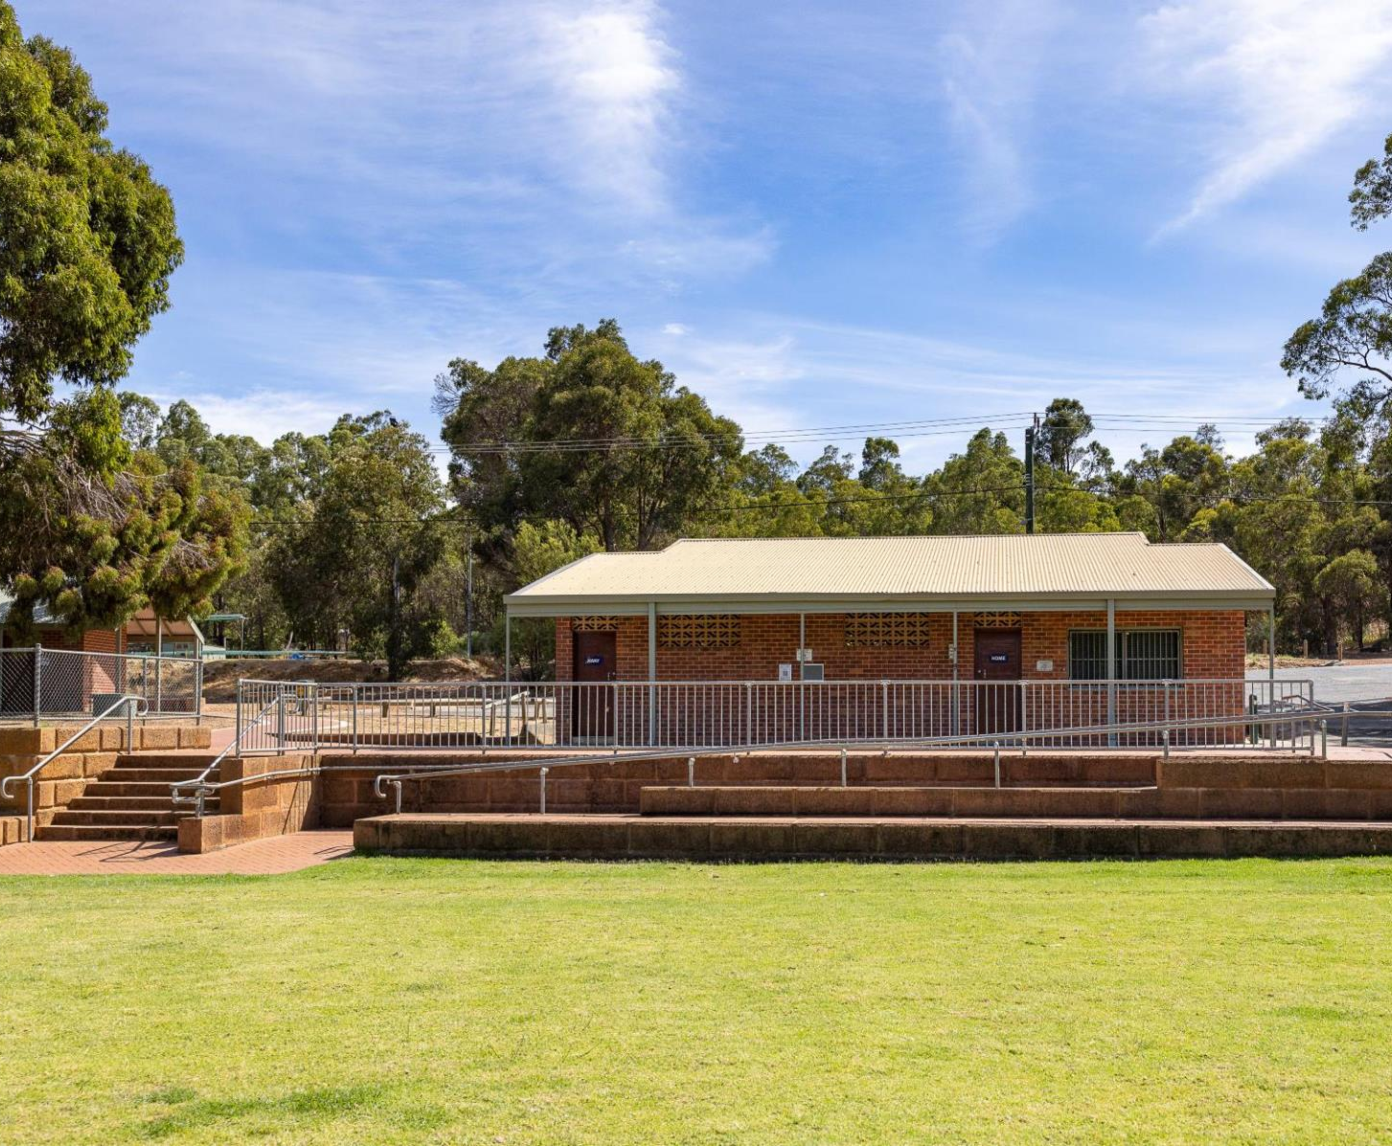
Overview of workshop
Meet the Team behind the Project
  NEW Specialist Role-support all community queries
  maarch* Architects
Walkthrough the design
  How have we done?
Over to you: Your questions and feedback

Slide 4
maarch* architects
Who are we and how do we do this?

Slide 5
maarch* architects
maarch* is a Perth‑based architecture and design studio with a strong focus on thoughtful, data‑driven design and collaborative project development.
They specialise in shaping projects that respond to:
  the local context and site condition
  community needs and expectations
  planning and approval requirements
maarch* works closely with clients and stakeholders throughout the process to develop clear, practical design solutions that are well considered, deliverable, and built to last.

Slide 6
The Concept Design

Slide 7
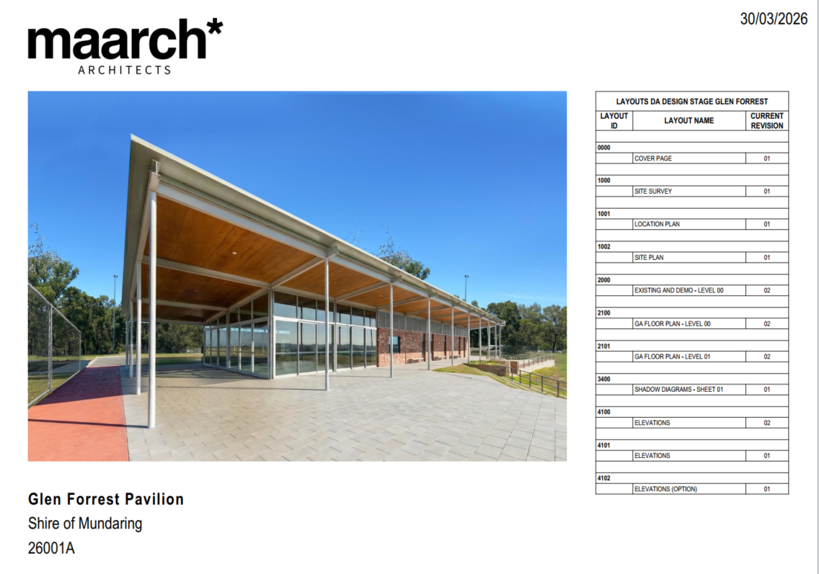

Slide 8
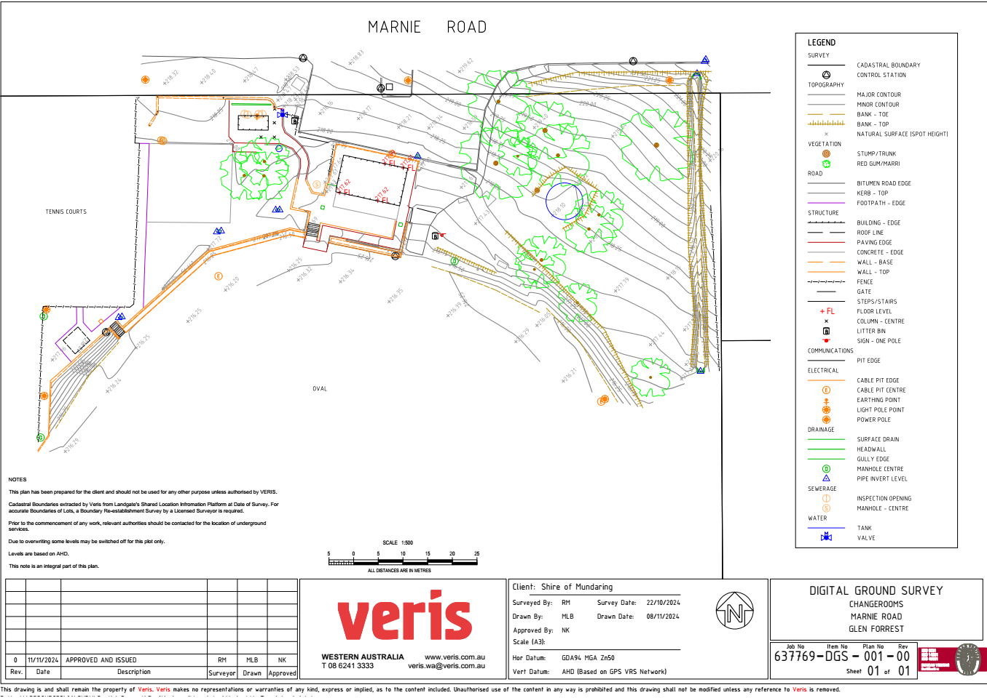

Slide 9
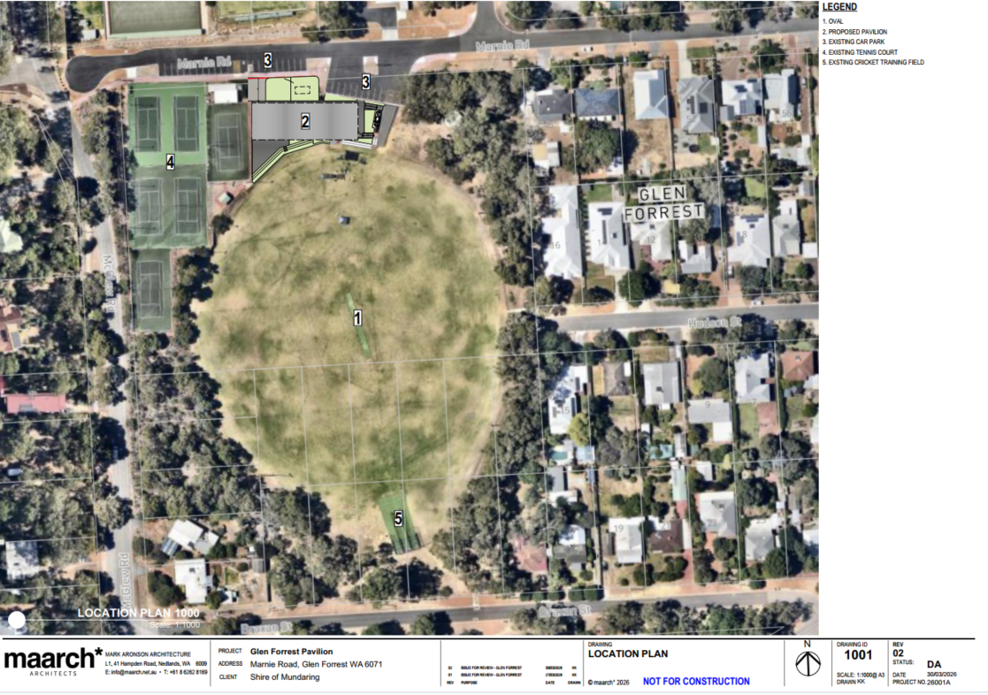

Slide 10
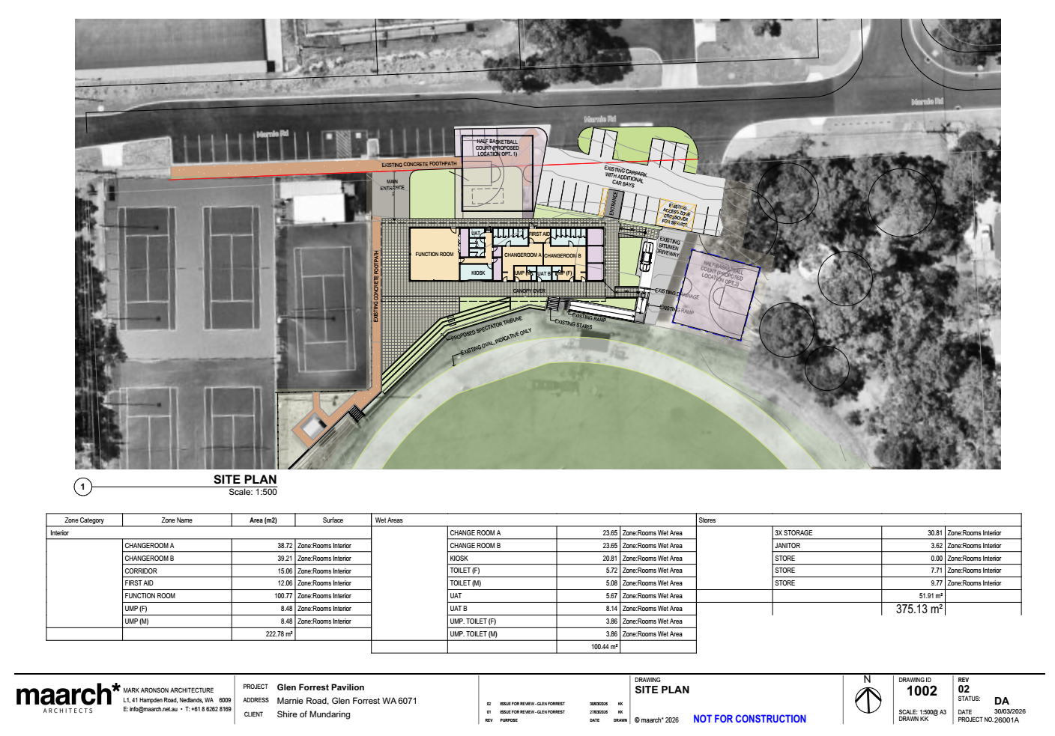

Slide 11
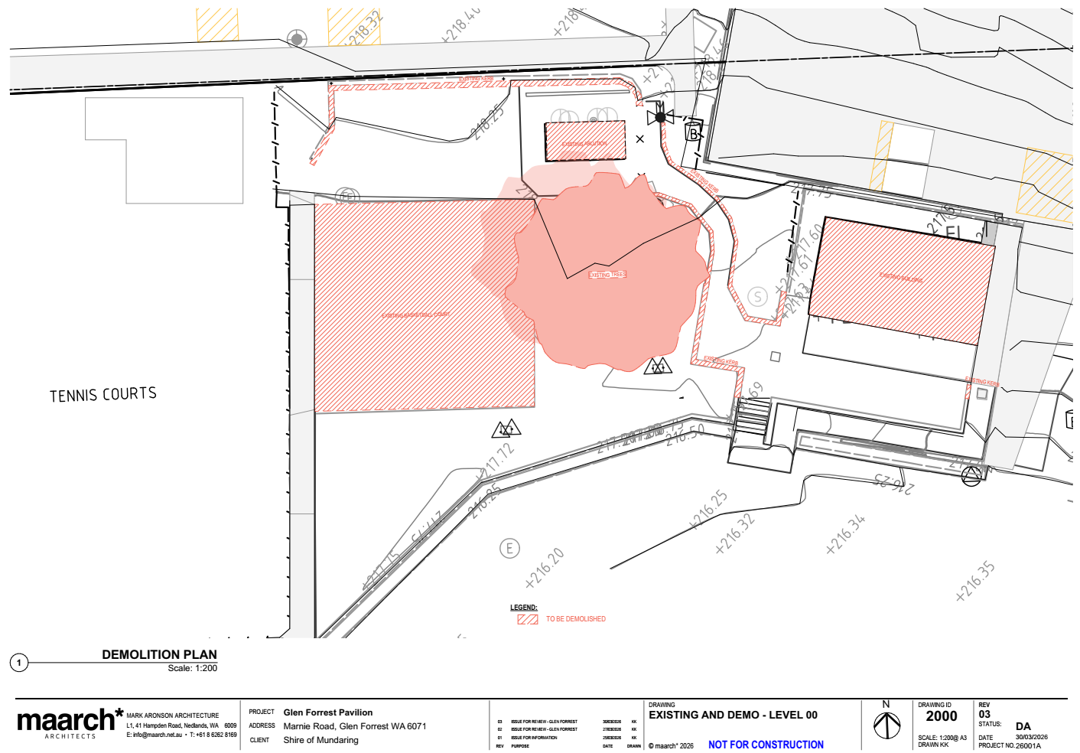

Slide 12
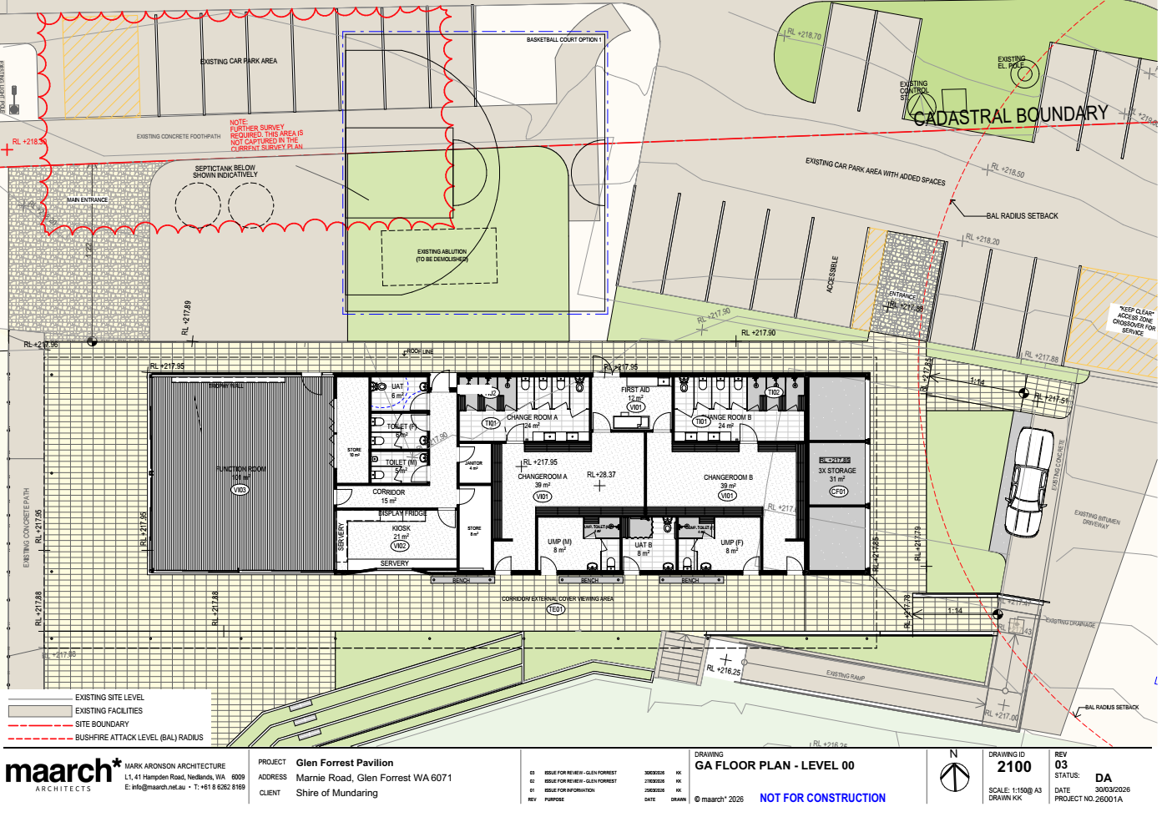

Slide 13
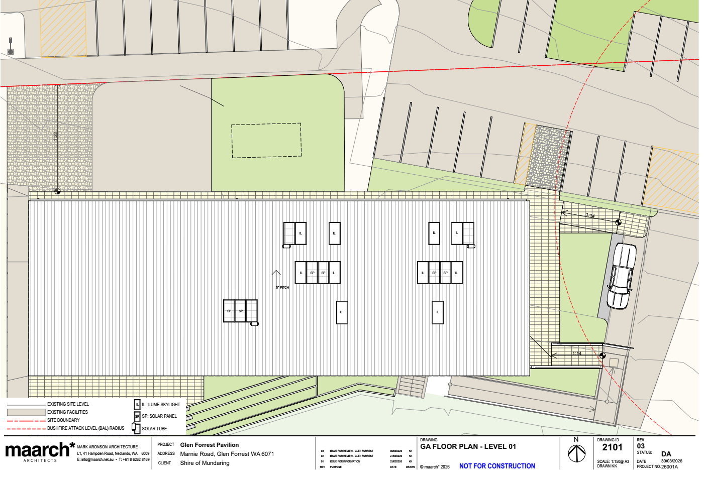

Slide 14
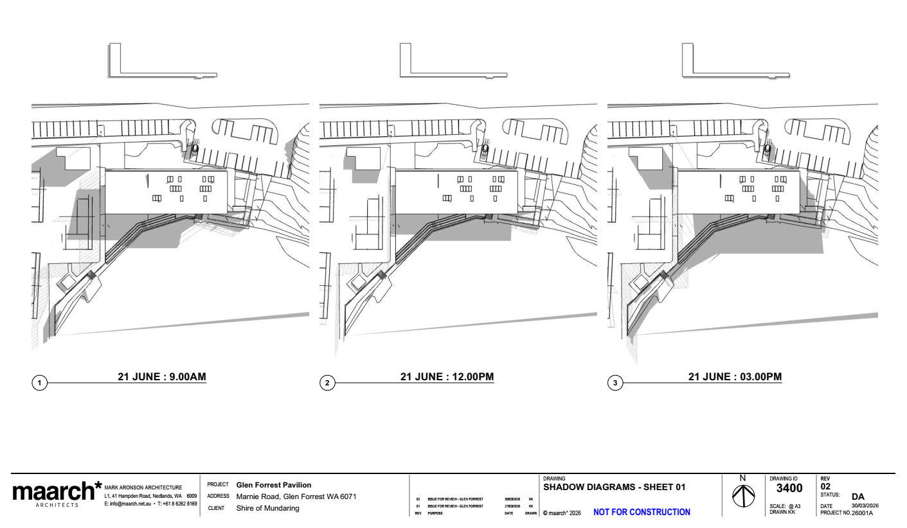

Slide 15
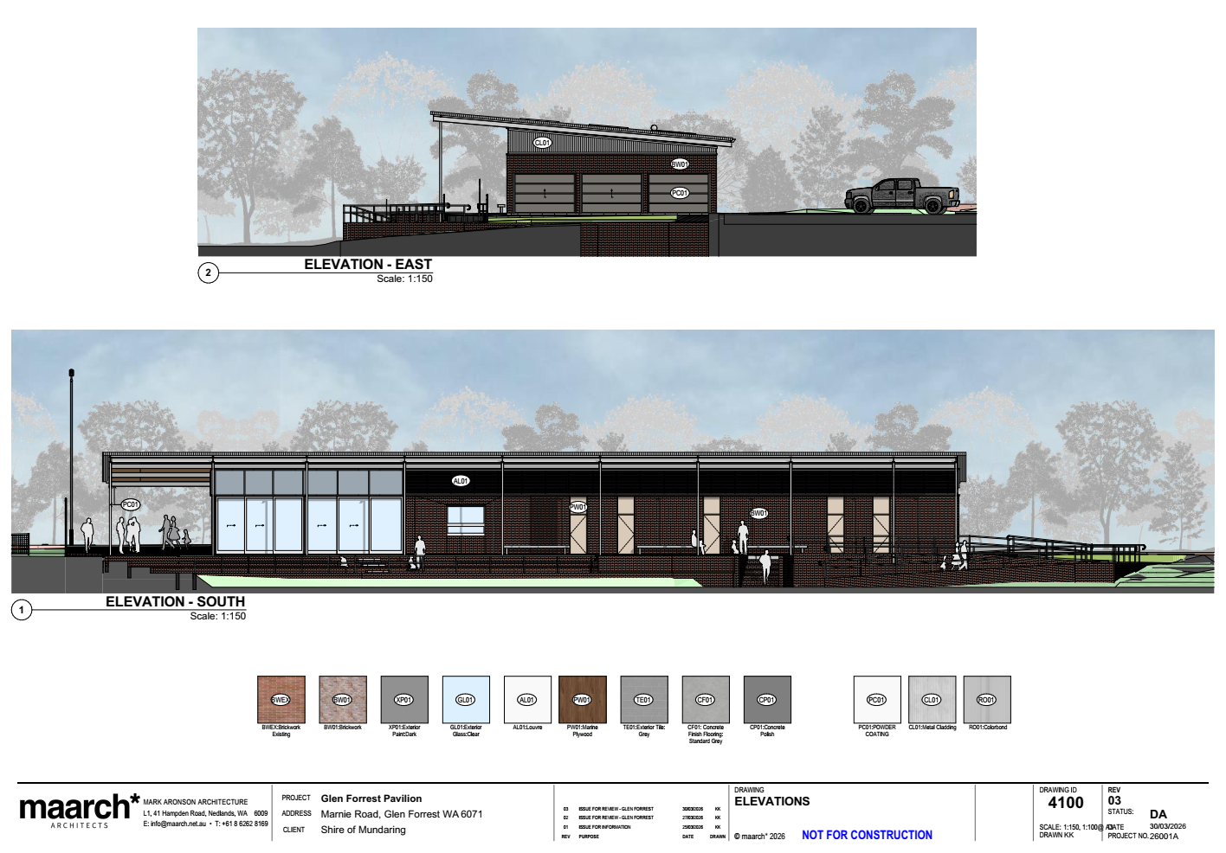

Slide 16
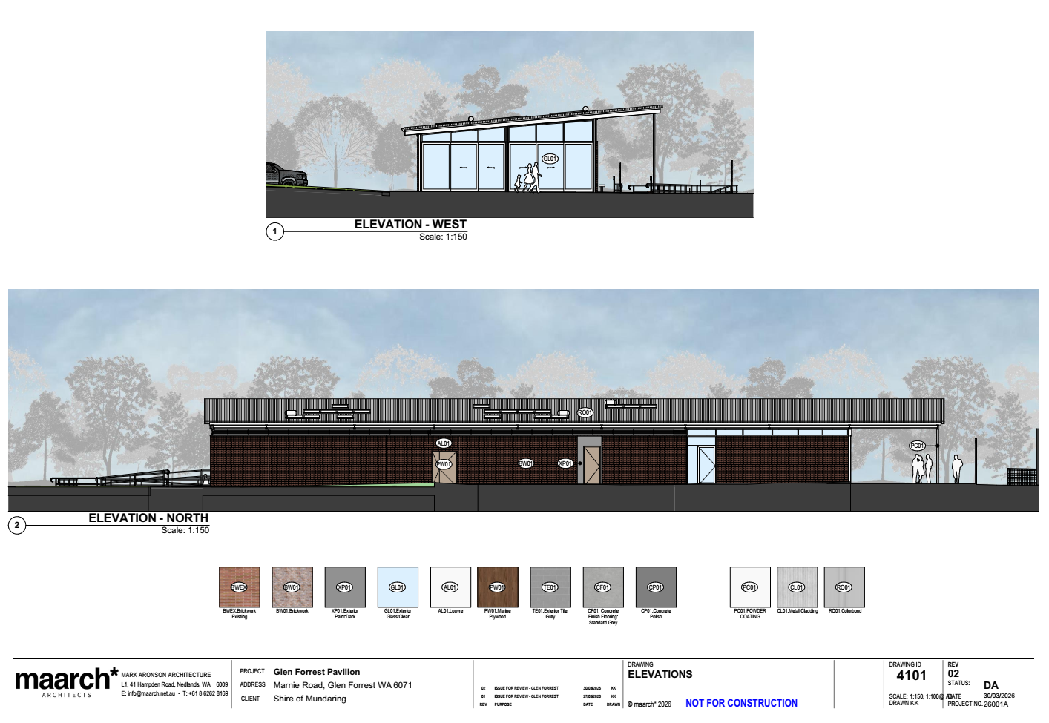

Slide 17
