Slide 1
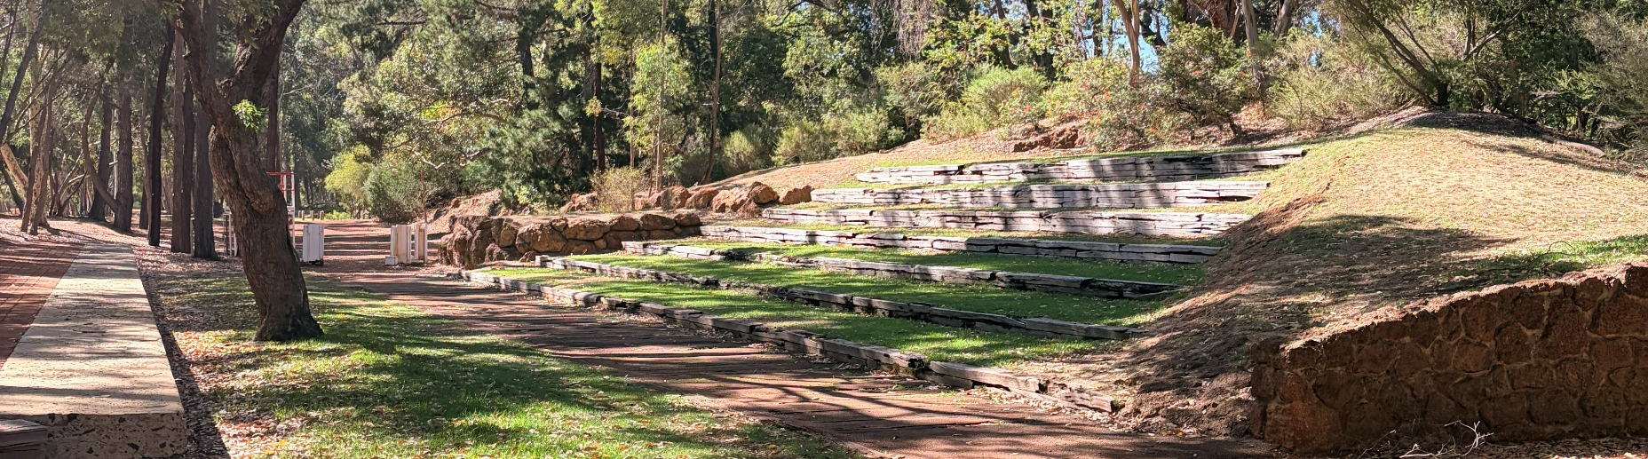
Mundaring Cultural Hub
Overview of Lease and Funding Considerations
25/03/2026

Slide 2
Background
Vurrent Lease has been

Slide 3
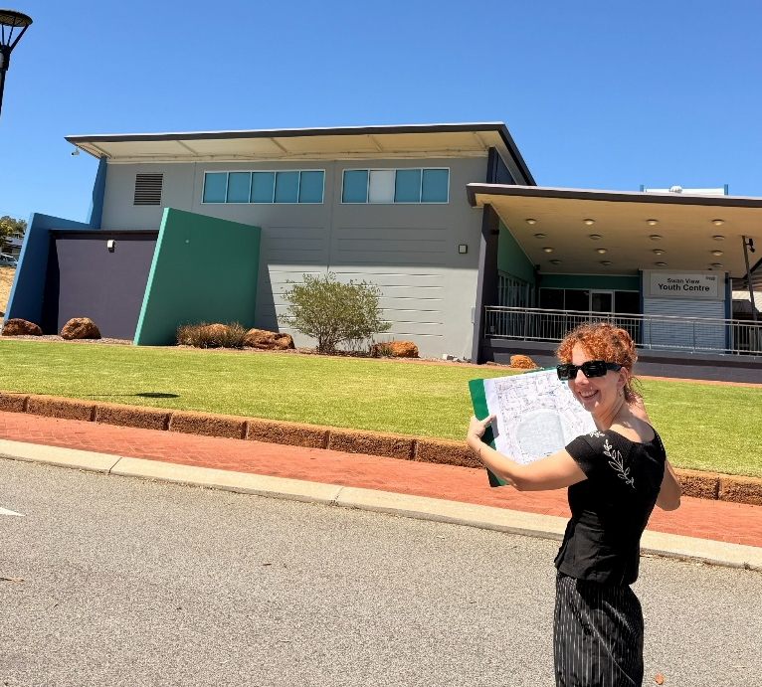
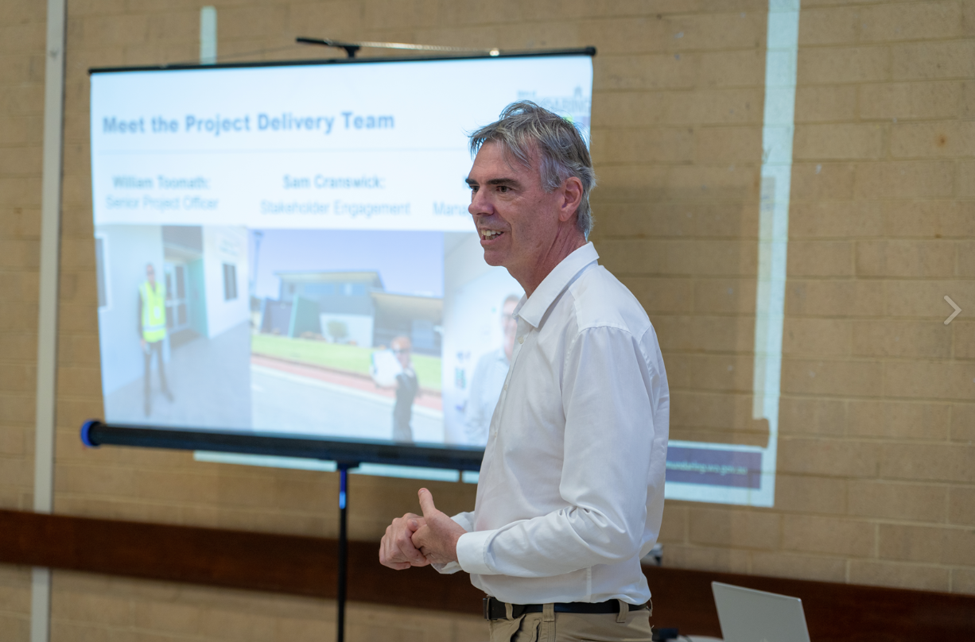
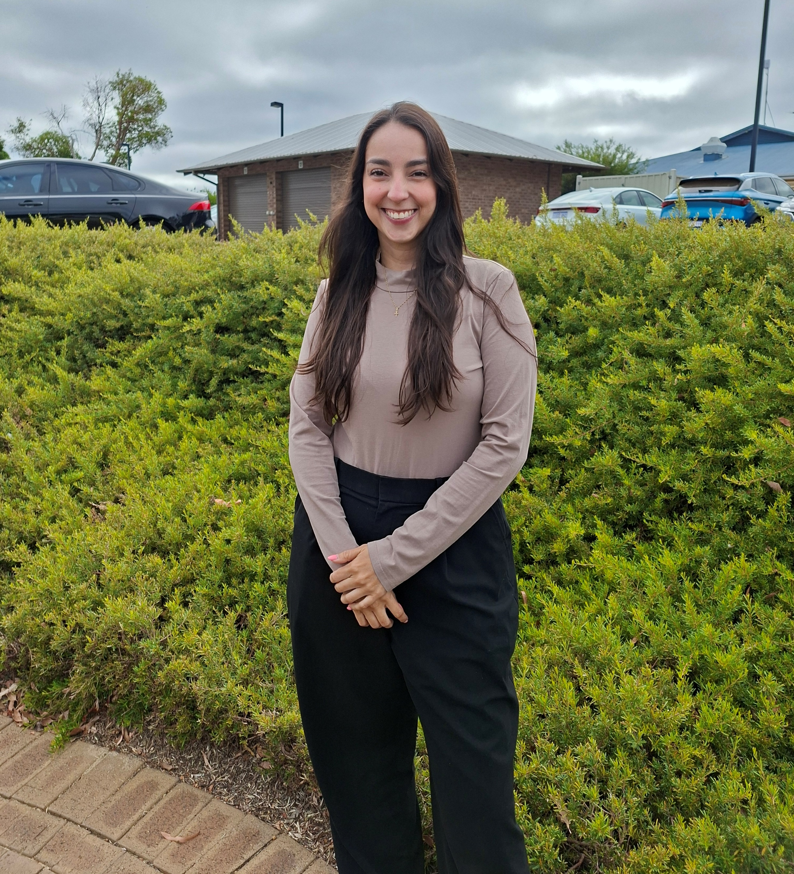
Meet the Project Team
Daniela Jaimes
Project Manager
Sam Cranswick:
Stakeholder Engagement
Nick Churchill:
Manager-Project Delivery

Slide 4
Meet the Designers
The people bringing the ideas for Sculpture Park to life

Slide 5
Plus Studio
Who they are:
A multidisciplinary design and architecture studio with offices across Australia and New Zealand, including in Perth.
Known for blending creative vision with practical delivery to shape places that work for people and communities.
Experienced in public space design, master planning and community‑focused environments.
What they bring to this project:
Collaborative design approach – listening to community needs and responding with thoughtful design.
Context‑driven solutions – crafting spaces that connect to their surroundings and community life.
Experience with flexible public spaces that support everyday use, events, and activation.
Plus Studio’s role is to help create a Sculpture Park that is accessible, vibrant, and enjoyable for people of all ages.

Slide 6
The Story So Far
Where does this fit into the broader Cultural Hub picture?

Slide 7
The why?
The Sculpture Park has always been a key community space, with strong cultural and heritage value. Over time, different studies and community feedback have highlighted opportunities to improve it.
Right now, activity is concentrated in one area, and the rest of the park is underutilised. There are also challenges around connectivity, arrival experience, and overall activation. So, this project is about unlocking the full potential of the park.
And making it a more connected, inclusive, and vibrant part of the Cultural Hub.

Slide 8
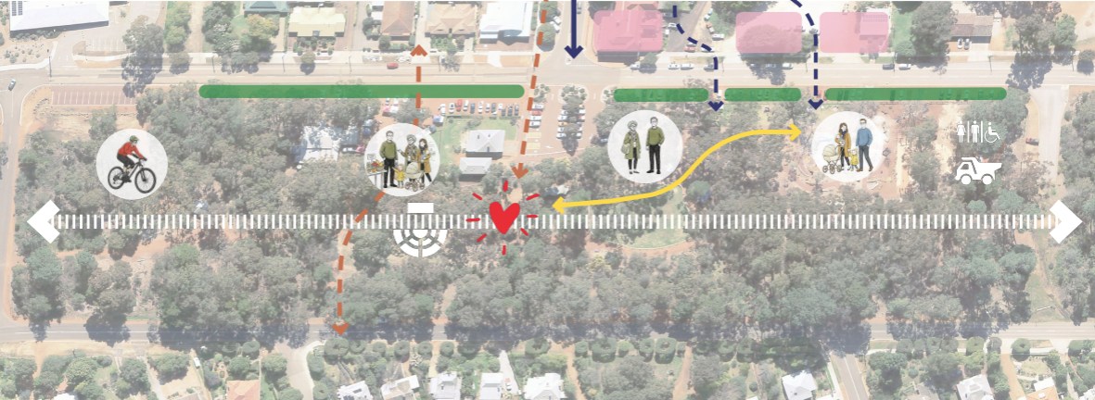
Our Early Ideas
Creating a flexible space that can support markets, events, and everyday community use
Upgrading the Amphitheatre to better host performances and gatherings
Introducing play elements to attract families and encourage longer visits
Activating the park from the playground through to the Scouts Hall
Improving connections and flow between key areas across the site
Enhancing comfort with better seating, shade and informal gathering spaces
Building a vibrant, welcoming place for people of all ages to enjoy

Slide 9
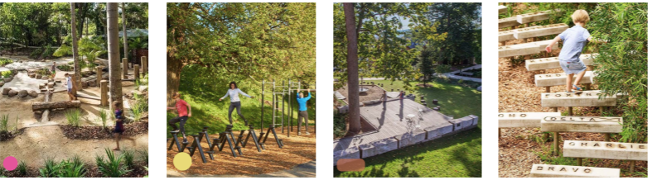
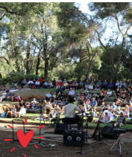
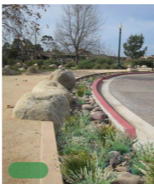
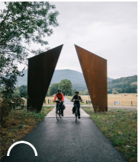
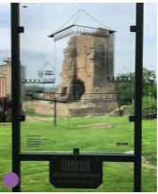
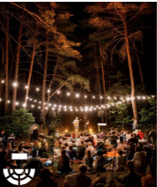
Project Vision Board

Slide 10
What Would You Like to See Here?
Help us create your ideal Wishlist for the project!

